Slide 1

Restaurants on the Ave-- Survey Analysis
Jack, Cherry, Gantcho

Slide 2
Why we choose this topic?
Ensure fairness in voting
---Include all types of restaurants (American, Mexican, Thai, Korean, Chinese)
Avoid voting with options that are unfamiliar to participants
---Restaurants on the AVE are accessible to all UW students

Slide 3
Criteria
Overall Performance
Food Quality
Customer Service
Restaurant Environment
Confidence Score (Make sure the score & ranking they provided is reasonable)

Slide 4
Datasets
11 participants, 12 restaurants, 44 rankings
Original Dataset: Restaurants on the Ave.csv (Google Form)
Ranking datasets:
WXML dataset – OP Ranking.csv
WXML dataset – CS Ranking.csv
WXML dataset – FQ Ranking.csv
WXML dataset – RE Ranking.csv
(For each criteria, integrate the ranking given by each individuals to an overall ranking)

Slide 5
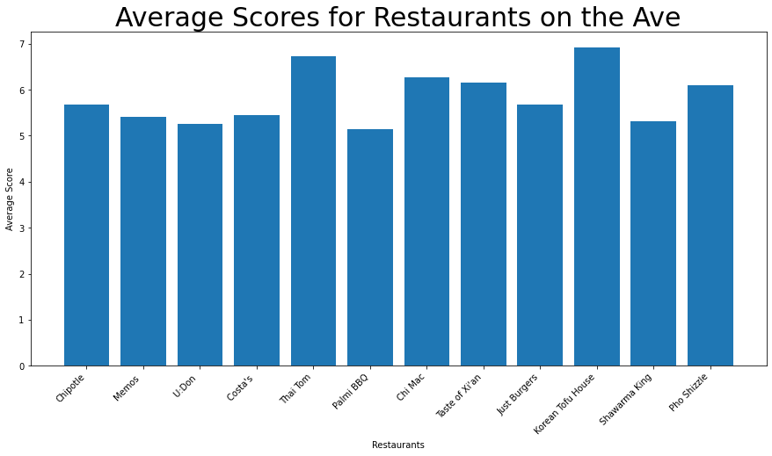
Data Visualizations – Average Score

Slide 6
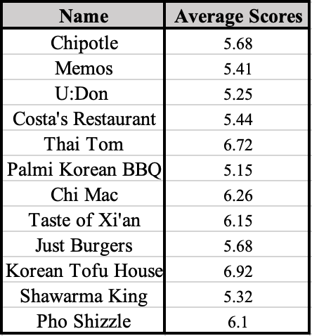
Data Visualizations – Average Score

Slide 7
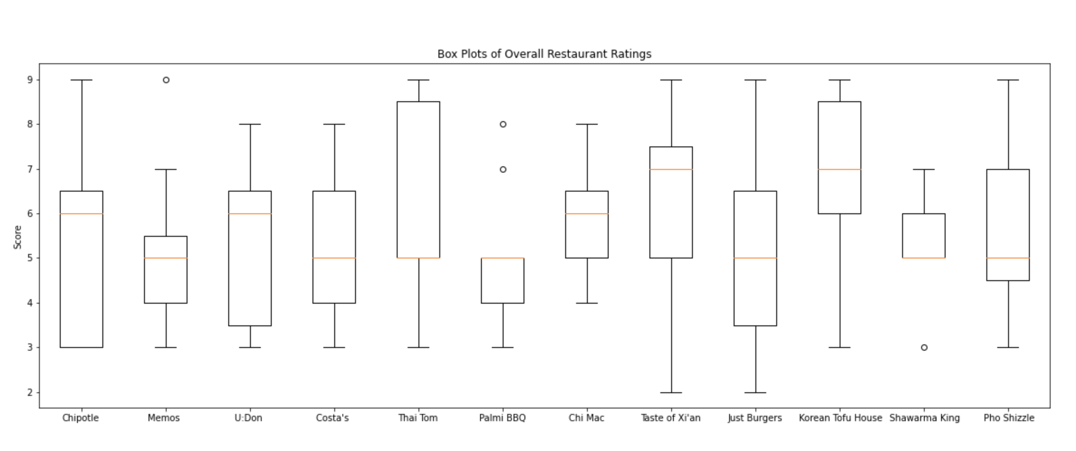
Overall Performance Boxplots

Slide 8
Analysis
Based on the average for overall performance score, Top 3(Korean Tofu House, Thai Tom, Chi Mac)
The gap is very small. The average score for all restaurants was concentrated in the range 5 – 7 points

Slide 9
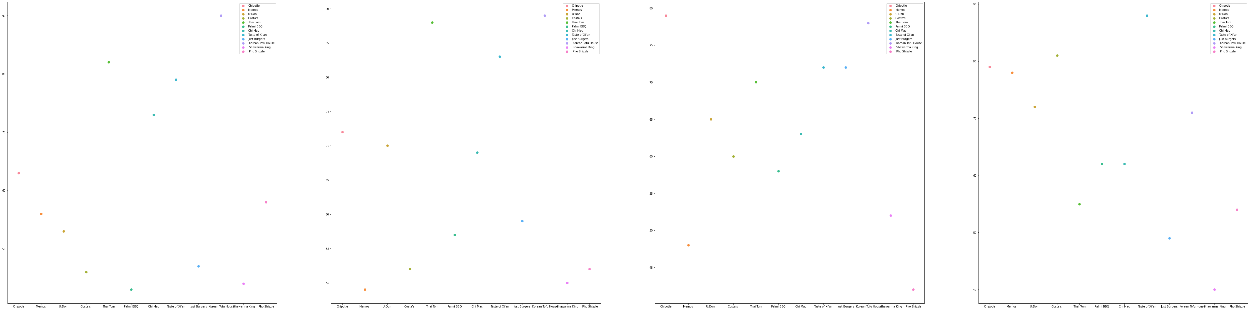
More plots based on rankings (Larger graphs)

Slide 10
Top3 Comparison
Overall Performance Ranking: Korean Tofu House, Thai Tom, Taste of Xi’an
Food Quality Ranking: Korean Tofu House, Thai Tom, Taste of Xi’an
Customer Service Ranking: Chipotle, Korean Tofu House, (Taste of Xi’an, Just Burgers tied)
Restaurant Environment Ranking: Taste of Xi’an, Costa’s, Chipotle

Slide 11
Relationship between a single criteria and the overall performance ranking
Assigned Score for ranking
Rank1 – 12 points
Rank2 – 11 points
Rank12 – 1 point
Each restaurants have a total score in each criteria.
Draw regression lines to see the relationship between each criteria and total performance scores.
Notes:
We ask the participants to rank not only the overall performance, but also each criteria. I am really curious that would the score in each criteria affects the overall performance score. Thus, I do some further research.

Slide 12
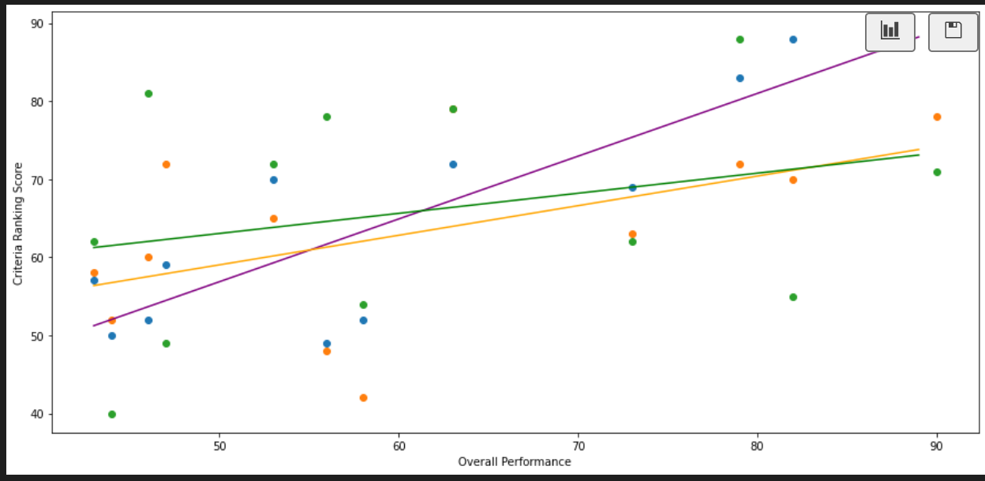
Regression Analysis
Purple: Food Quality
Orange: Customer Service
Green: Restaurant Environment

Slide 13
Conclusion
Korean Tofu House win!!!!!!!!!!!!!!!! Congratulations
When evaluating a restaurant, people pay more attention on food quality.
When we need to make an overall assessment of something, even if we have different criteria, we tend to make a decision based on one or two of them.

